Slide 1
Predict Hospital Resources
Team - Abhishek Srivastava, Swati Kumari, Linde Yang(David)

Slide 2
Introduction
Identified Problem Areas:
A major challenge in dealing with Corona is Limited Hospital Resources - Hospital Beds, ICU, Ventilators etc.
Impromptu schedules for health care workers.

Slide 3
Introduction
Identified Task:
Predict hospital resources to be required for next day.
Impact:
Better planning of resources before hand.
Doctors can efficiently manage schedules.

Slide 4
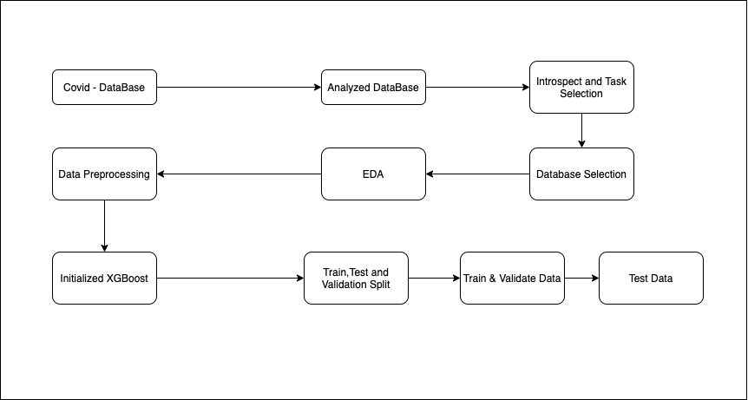
Workflow

Slide 5
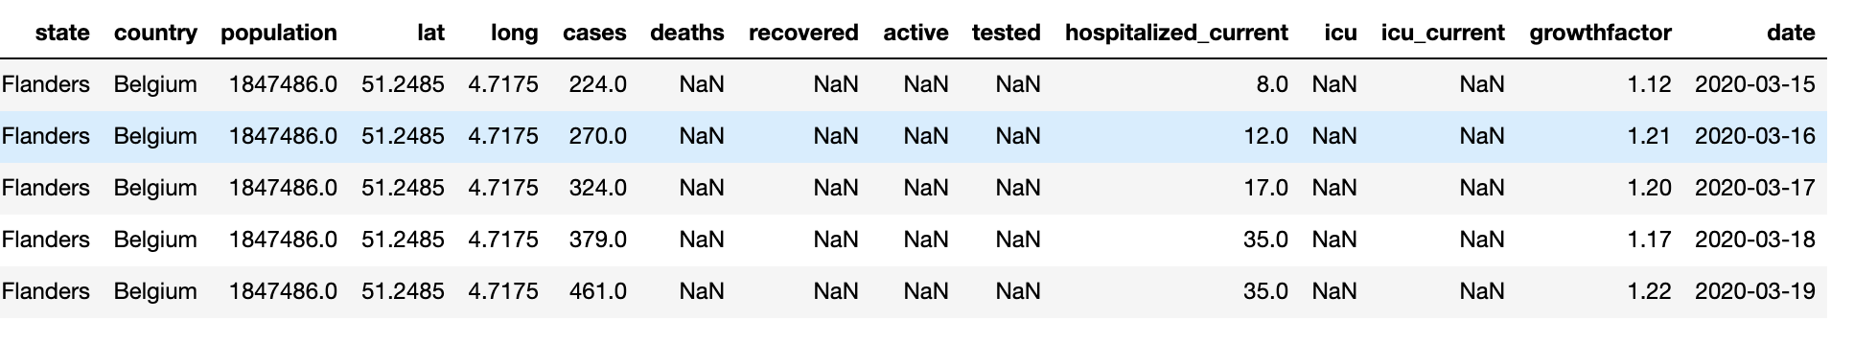
Data
We chose the database which had the following data:
After removing null values we had 5423 rows.

Slide 6
Model Options
To work on time series data we considered the following options:
Linear Regression - Ridge -> Data had missing values.
Time Series - ARIMA, Prophet -> Data had missing values and was not present at consistent time intervals.
Decision Trees - XGBoost -> supports NaN and gives good performance.

Slide 7
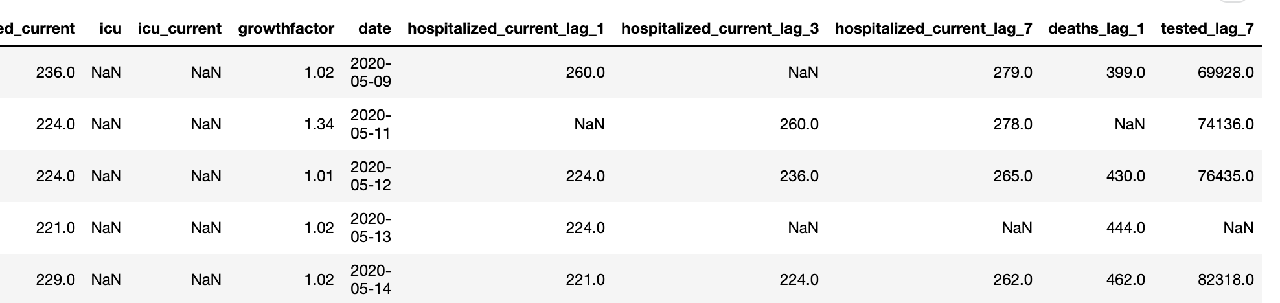
Data Conversion
Created lags for 3 columns - hospitalized_current, deaths and tested. Time component captured with these new columns.
New data has 5,813,255 rows.

Slide 8
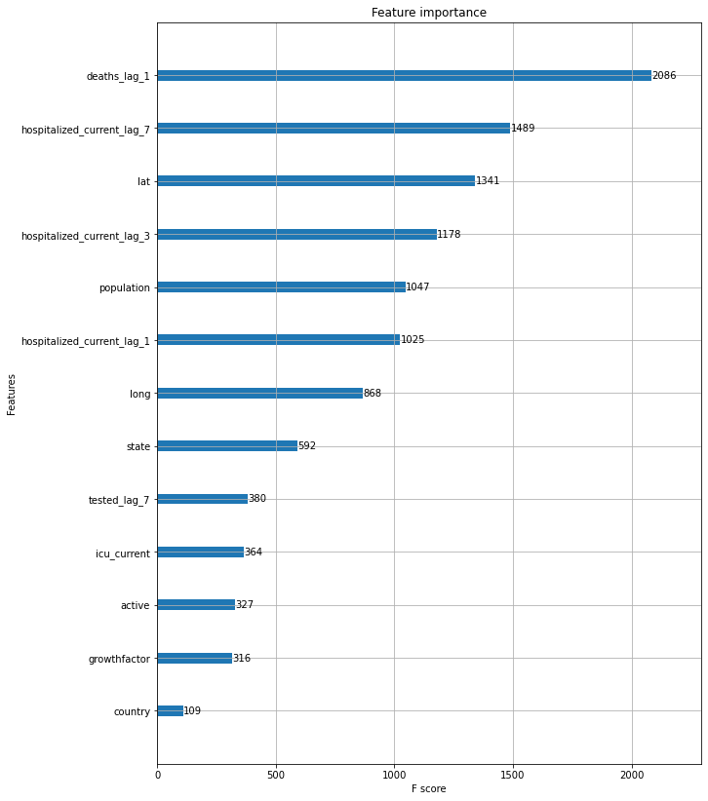
Analysis

Slide 9
Analysis
Most important features are deaths previous day, hospitalization one, three, seven days back, geo-spatial location and population.

Slide 10
Findings
Got a model with rmse score of .39 on test data.
Could be used to better prepare resources for next day.
Management can plan beds and medicines.
Doctors can plan their schedule accordingly.

Slide 11
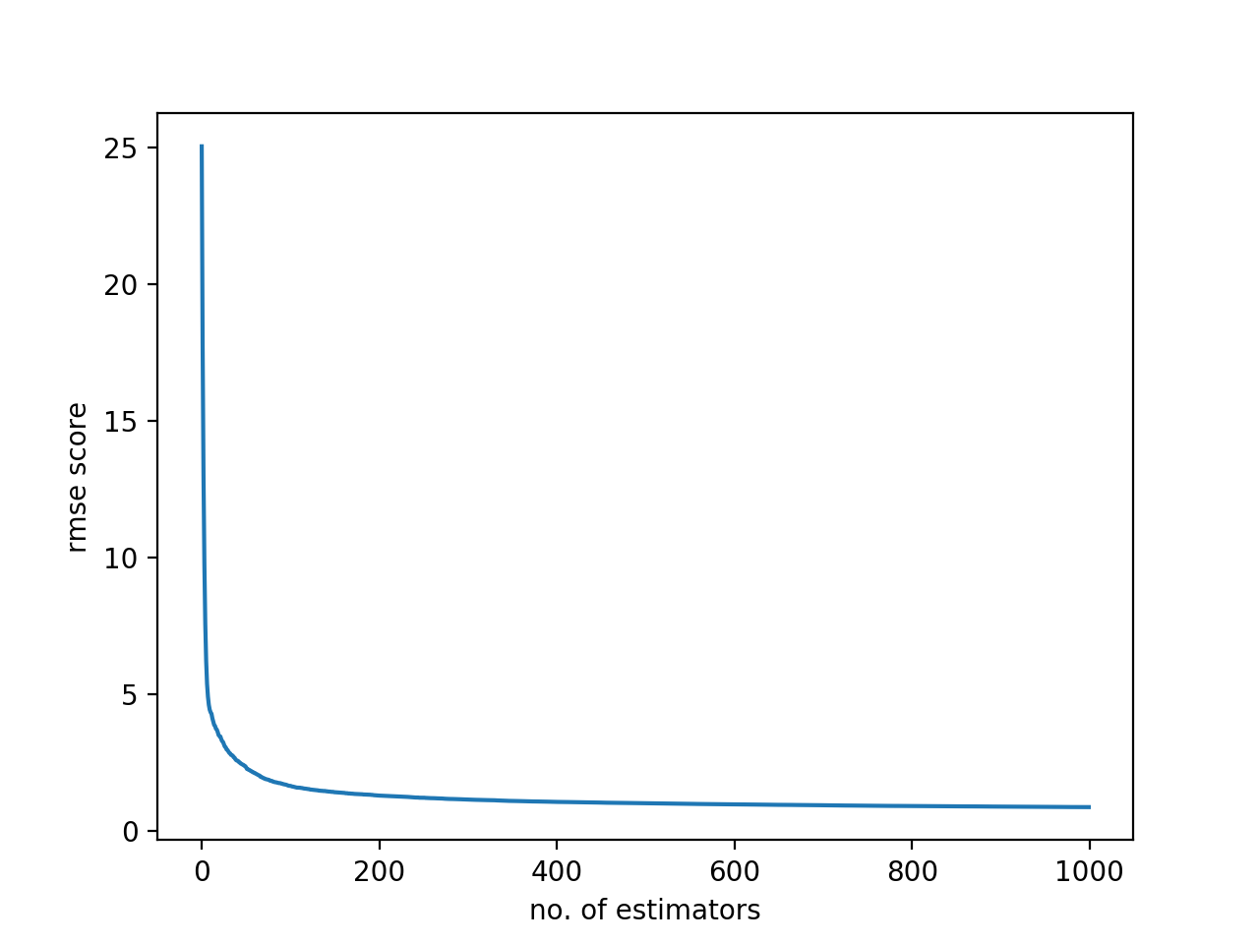
Findings

Slide 12
Challenges
Selecting Database to choose the task.
A lot of the data was missing.
Finding Database with good quality data.
Resource Limitations (Memory).

Slide 13
Future work
Could be improved more by utilizing more features but that will require more memory.
Extend the model to predict hospital resources for next 7 days.
Extend the same idea to explore use of ICUs and Ventilators.

Slide 14
Conclusion
Analysed importance of different factors on Hospital Resources.
Experimented with different models.
Choose the best model which can predict hospital resources for next day.

Slide 15
Questions?

Slide 16
Thank you

